Slide 1


DARS
Data Analysts for your Recommender System

Slide 2
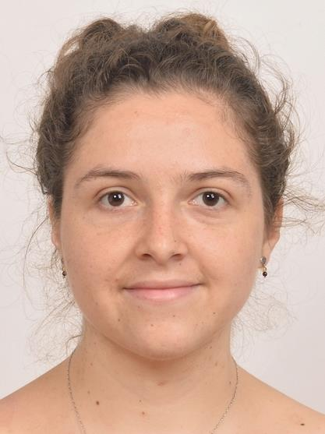
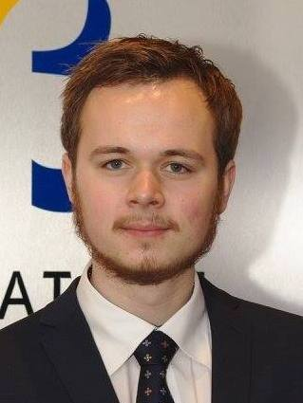

Sofia Vazquez Alferez
sofia.vazquezalferez@maastrichtuniversity.nl
Raphaël Morsomme
raphael.morsomme@maastrichtuniversity.nl

Slide 3

Content
The Project & what we’re doing
The Recommender System
Prototype
Contact details

Slide 4
1. The Project & What we’re doing

Slide 5
The Project
Started in September 2018
Recommender System for MSLAS Students
Supporting Team:
Department of Knowledge Engineering, Maastricht University
Institute for Data Science, Maastricht University

Slide 6
GOAL
Help students make well-informed decisions with regard to course selection
Improve self- and academic advising

Slide 7
Stakeholders
Curriculum Development
Students
Academic Advisors

Slide 8
2. The Recommender System

Slide 9
Recommender System for Students
Topic Modelling
Predictive Model
LDA
Regularized linear regression
Course Recommender System
output =
Course Recommendations
output =
Warnings & preparation

Slide 10
Topic Modelling
Input Text
Course Manuals
Course Catalogue
Fit Topic Model
n topics (5 – 250)
Model Selection
Perplexity
Topic Profile of Student & Course Recommendation
Key words
LDA
Log Likelihood
Previous courses
Coherence
alpha
beta
Vary:

Slide 11
Predictive Model
Input Transcripts
2014-2018
Fit Linear Model
Grade prediction
Warnings
Lasso
Cross-validation
Predictors
GPAs
Topic expertise
A model for each course
GPAs
Topic expertise
Current student profile

Slide 12
3. Prototype

Slide 13
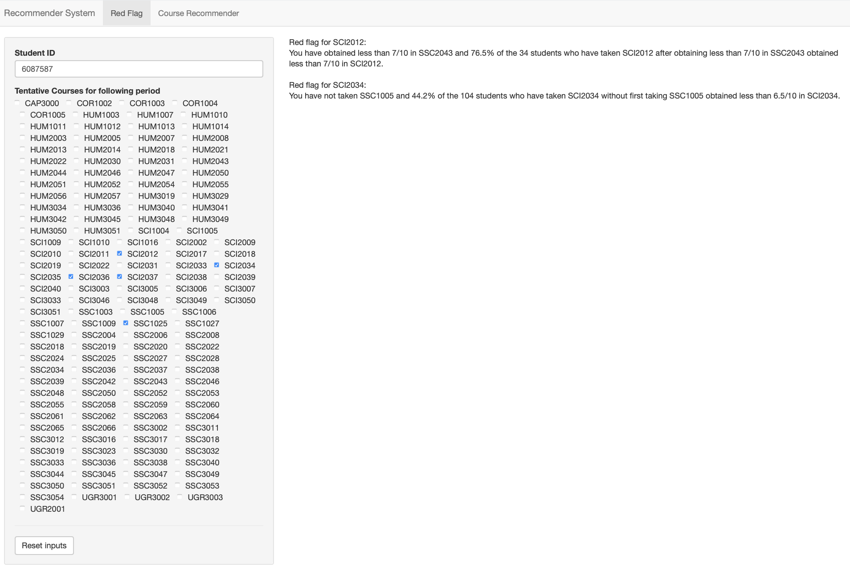

Slide 14
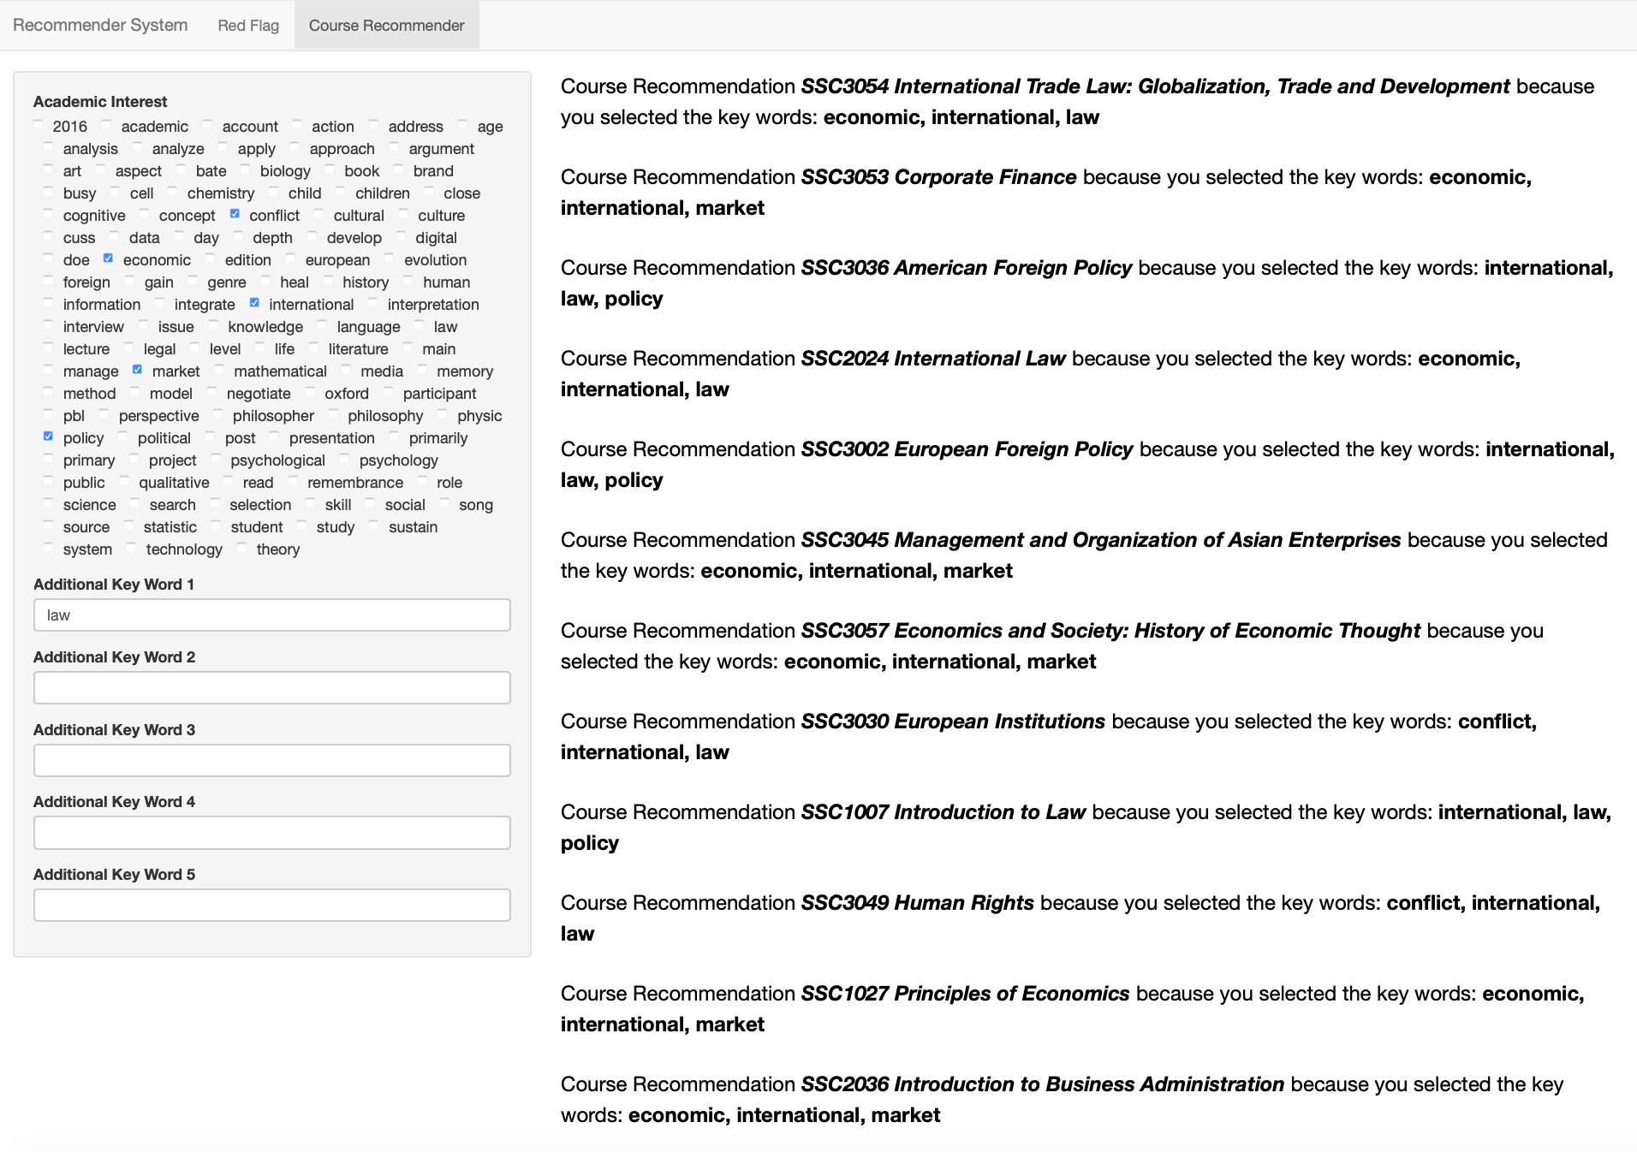

Slide 15
Contact:
Sofia Vazquez Alferez
sofia.vazquezalferez@maastrichtuniversity.nl
Raphaël Morsomme
raphael.morsomme@maastrichtuniversity.nl

